Slide 1

GPS ENABLED PATH FOLLOWING BOT
PROJECT BY
DYUti Ghosh

Slide 2

CONCEPT
CONTROLLED BY CELL PHONE
PRESS BUTTON
“GO TO WAYPOINT”
BOT GOES TO DESIRED LOCATION
DISPLAY “DESTINATION REACHED”

Slide 3





F
E
A
T
U
R
E
S
Obstacle
Avoidance
Steering – Front, Reverse, Left, Right, Stop
Compass Enabled GPS Steering
Shortest Path Detection

Slide 4

COMP
ON
E
N
T
S
HMC5883L magnetometer/ compass
GPS Module Ublox Neo-6m
Ultrasonic sensor HC – SR04
HC06 Bluetooth module
Arduino Nano
Chassis
L298n Motor Driver
BO(Battery Operated) Motor & Wheel
18605 Li battery and Connecting Wires

Slide 5
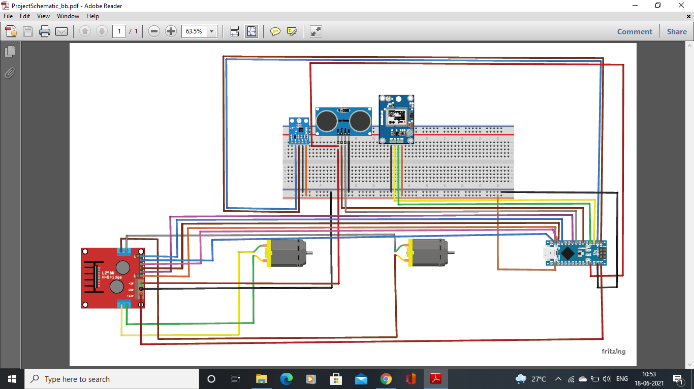
CIRCUIT DIAGRAM

Slide 6
METHODOLOGY

Slide 7
BLUETOOTh COMMANDS
Command No. | Command
1 | Forward()
2 | Reverse()
3 | LeftTurn()
4 | RightTurn()
5 | StopCar()
6 | setWaypoint()
7 | goWaypoint()
8 | turnAround()
Command No. | Command
9 | Compass_Forward()
10 | setHeading()
11 | gpsInfo()
12 | CompassTurnRight()
13 | CompassTurnLeft()
14 | calibrateCompass()
15 | pingToggle()
16 | clearWaypoints()
17 | Waypoints Complete

Slide 8
OBSTACLE
AVOIDANCE
We have used HC-SR04 ultrasonic sensor to give our bot the perception of distance
The distance has been calculated using
Distance = ½ T x C
(T = Time
C = the speed of sound=343m/s)
The sensor gives readings of T in µs.
1m=39.36inch
Therefore,
Distance (in inch) = ½ T x 1/74
While moving forward, if this distance if found to be less than a minimum value (here taken to be 12 inches), then the car is quickly reversed and stopped.

Slide 9



Forward – All 4 motors move forward
Reverse – All 4 motors move backward
Left Turn – Motor 1 and 4 move backward, 2 and 3 move forward
Right Turn – Motor 1 and 4 move forward, 2 and 3 move backward
GENERAL STEERING
Slow Left Turn – Left Turn with specified turn_speed
Slow Right Turn – Right Turn with specified turn_speed
Stop Car – Release all motors

Slide 10
COMPASS DRIVE
This is to steer the vehicle based on the compass heading
CompassTurnRight()
To turn the car to the right based on the current desired heading
CompassTurnLeft()
To turn the car to the left based on the current desired heading
Compass_Forward()
If the Desired Heading and the Compass Heading are within the compass deviation then Go Forward. Otherwise find the shortest turn radius and turn left or right
turnAround()
This procedure turns the Car around 180 degrees, every time the "Turn Around" button is pressed

Slide 11
GPS COMPASS
calibrateCompass()
To read raw compass data and set calibration offset
getGPS()
To get Latest GPS coordinates
clearWaypoints()
To clear waypoints
setWaypoint()
To set up to 5 GPS waypoints
getCompass()
To get latest compass value
gpsInfo()
To display Satellite data to user
setHeading()
To set the current heading of the robot going away and returning using opposing degrees from 0 to 360.

Slide 12
GO TO WAYPOINT
Go_Home procedure using
Bluetooth command No. 7
Retrieve GPS Data
Stop the robot after each waypoint is reached. Display Message.
IF, GPS Course and the Compass Heading are within x (here=15) deg of each other, go Forward
ELSE, find shortest turn radius & turn left or right

Slide 13
STARTUP
After starting up, wait until x (here taken 4) number of satellites are acquired before starting main loop
Update GPS Data
Check to see if there are any bluetooth commands being received
Set initial waypoint to current location

Slide 14
GPS GUIDED ROBOT
GPS Variables
Driver Motors
Compass Variables
SET-UP
Ping Sensor for Collision Avoidance
Bluetooth Variables
Variables for storing GPS Locations
Run the Bluetooth procedure to see if there is any data being sent via BT
MAIN
LOOP
Update the GPS location
Update the Compass Heading

Slide 15





APPLICATIONS
DEEP OCEANS
The exposure to hazards are mitigated to the person who operate the vehicle from a location of relative safety.
APPLICATIONS
Space exploration
As fire extinguisher car
Military
engagements

Slide 16

THANK YOU

